Slide 1
Advanced Topics on Massive Parallel Data Processing with R,
Big R, and SystemML
Oscar D. Lara Yejas, Berthold Reinwald
IBM
Meetup “Cloud Scale Data Science Virtual UserGroup”
April 22th, 2015
Notes:
IBM Insight 2014

Slide 2
Open Source R’s Strengths… and Weaknesses
Free
Data Exploration
Large Data Volumes
Vibrant Growing Community
Descriptive Statistics and Machine Learning
Not Naturally Hadoop Friendly
Industry Commitment
Visualization
Scalable
Algorithms
Notes:
IBM Insight 2014

Slide 3
3 Key Capabilities in IBM Big R
1
Use of R as a query language on big data
  Scalable data querying
Running native R functions in Hadoop
  Can leverage existing R assets (code and packages)
Running scalable algorithms beyond R in Hadoop
  Wide class of algorithms and growing
  R-like syntax to develop new algorithms and customize existing algorithms
2
3

Slide 4







Big R Architecture
R User
Interface
IBM BigInsights
Data Scientist 4.0.0
Scalable Data Querying
Native
R functions
Scalable
Algorithms
1
2
3

Slide 5
Big R as a query language on Big Data
1
# Construct a bigr.frame to access large data set
air <- bigr.frame(dataPath="airline.csv", …)
# How many flights were flown by United or Delta?
length(air$UniqueCarrier[air$UniqueCarrier %in% c("UA", "DL")])
# Filter all flights that were delayed by 15+ minutes at departure or arrival.
airSubset <- air[air$Cancelled == 0 & (air$DepDelay >= 15 | air$ArrDelay >= 15),
c("UniqueCarrier", "Origin", "Dest", "DepDelay", "ArrDelay")]
# For these filtered flights, compute key statistics (# of flights,
# average flying distance and flying time), grouped by airline
summary(count(UniqueCarrier) + mean(Distance) + mean(CRSElapsedTime) ~ UniqueCarrier,
dataset = airSubset)
bigr.histogram(air$Distance ~ air$UniqueCarrier, …)
Data not loaded into R but proxy to BigInsights cluster
Apply predicates and compute length of result vector
Run query for groupBy and multiple aggregate functions

Slide 6
Summary of Big R capabilities
 | Big R Function
Connection | connect, disconnect, …
HDFS | listfs, rmfs
Types & Functions | Types | bigr.frame, bigr.vector, bigr.list, bigr.matrix
 | Functions | dim, nrow, colnames, coltypes, head, tail, na.string, na.omit, sort
 | Coercion and Casting | as.bigr.frame, as.data.frame, … as.vector as.integer, as.logical, as.numeric
Built-in Functions | Arithmetic | +, -, *, /, ^
 | Mathematical | abs, acos, asin, atan, ceiling, floor, exp, …
 | String | grepl, substr
 | Aggregate | summary() with min(), max(), sum(), …
 | Statistical | cor, cov, mean, sd
Miscellaneous | attach, bigr.pull, bigr.random, bigr.sample, ifelse
Visualization | bigr.histogram
Apply R functions | groupApply, tableApply, rowApply
Run scalable algorithms | bigr.lm, bigr.svm, bigr. … (see subsequent slide)
2
3

Slide 7
Applying native R functions on data partitions
2
# Filter the airline data on United and Hawaiian
bf <- air[air$UniqueCarrier %in% c("HA", "UA"),]
# Build one decision-tree model per airline
models <- groupApply(
data = bf,
groupingColumns = list(bf$UniqueCarrier),
rfunction = function(df)
{
library(rpart)
predcols <- c('ArrDelay', 'DepDelay',
'DepTime', 'Distance')
return (rpart(ArrDelay ~ ., df[,predcols]))
})
# Pull all models to client
rmodels <- bigr.pull(models)
Partition the data into groups…
Run this function on the cluster “as is” on each of the groups.

Slide 8
Run Scalable Algorithms beyond R – bigr.lm()
3
library(bigr)
conn <- bigr.connect(host="curly.almaden.ibm.com", user="biadmin", password="...")
airline <- bigr.frame ("DEL", "/user/biadmin/fullairline.csv", delimiter=",",
header=T, na.string="NA", ...)
# Data transformation step (recoding, missing values, binning, dummy coding, scaling)
airlineTF = bigr.transform (airline, …
recodeAttrs=c("UniqueCarrier", "TailNum", "Origin“, "Dest“,
"CancellationCode"),
missingAttrs=c("Diverted","CarrierDelay","WeatherDelay“),
imputationMethod=c("global_mean“)
binningAttrs=c("DepDelay), numBins=10, binningMethod="equi-width",
dummycodeAttrs=c("UniqueCarrier"))
# Scalable Linear Regression Model
airLM = bigr.lm (formula=ArrTime ~ ., data=airlineTF)
Perform data transformations
Invoke scalable algorithm linear regression in Hadoop

Slide 9
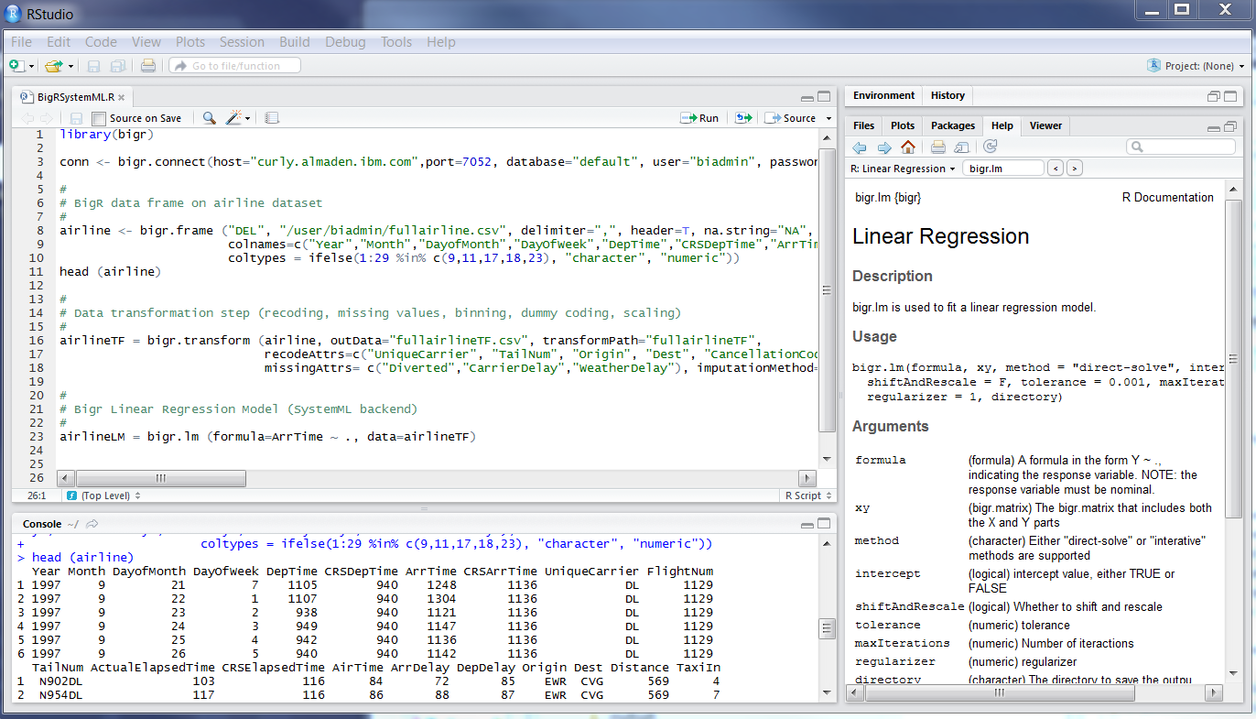
User Experience for Scalable Algorithms in Big R
Connect to BI cluster
Data frame proxy to large data file
Data transformation step
Run scalable linear regression on cluster

Slide 10
Scalable Algorithms in Big R
Category | Description |  | Big R Function
Descriptive Statistics | Univariate |  | bigr.univariateStats()
 | Bivariate |  | bigr.bivariateStats()
 | Stratified Bivariate
Classification | Logistic Regression (multinomial) |  | bigr.logistic.regression()
 | Multi-Class SVM |  | bigr.svm()
 | Naïve Bayes (multinomial) |  | bigr.naive.bayes()
Clustering | k-Means |  | bigr.kmeans()
Regression | Linear Regression | system of equations | bigr.lm()
 |  | CG (conjugate gradient descent)
 | Generalized Linear Models (GLM) | Distributions: Gaussian, Poisson, Gamma, Inverse Gaussian, Binomial and Bernoulli | bigr.glm()
 |  | Links for all distributions: identity, log, sq. root, inverse, 1/μ²
 |  | Links for Binomial / Bernoulli: logit, probit, cloglog, cauchit
Predict | Scoring |  | bigr.predict()
Transformation | Recoding, dummy coding, binning, scaling, missing value imputation |  | bigr.transform()

Slide 11


Slide 12
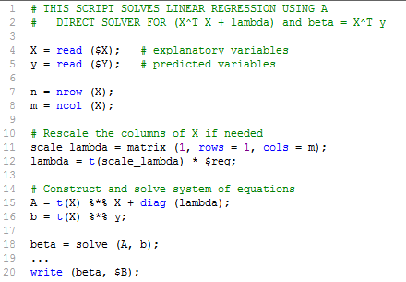
What’s behind Running Scalable Algorithms
Algorithms expressed in a declarative, high-level language with R-like syntax
Cost-based compilation of algorithms to generate execution plans
  Compilation and parallelization
    Based on data characteristics
    Based on cluster and machine characteristics
  In-Memory single node and MR execution
Enable algorithm developer productivity to build additional algorithms (scalability, numeric stability and optimizations)
bigr.lm()
Notes:
Confidential IBM/Expedia 9/13/11

Slide 13
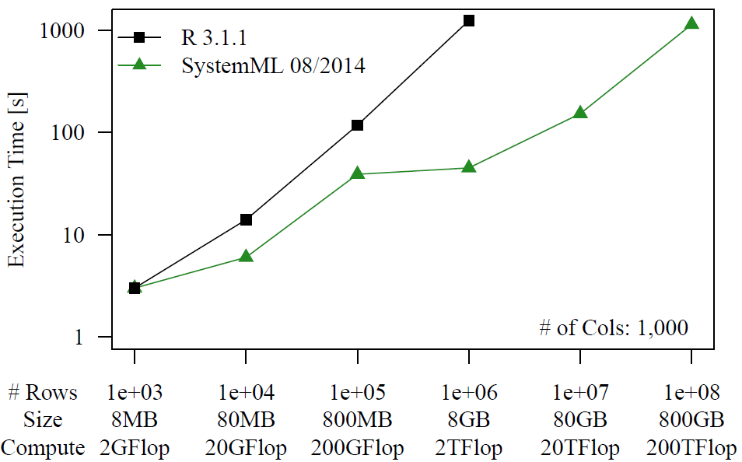
bigr.lm - Scalability and Performance
Performance
(data fit in memory)
R out-of-memory
Scalability
(data larger than
aggr. memory)
R 3.1.1 lm()
bigr.lm()
28x
Cluster
6 nodes w/ 12 cores each
M/R capacity: 144/72
M/R JVM: 2 GB

Slide 14
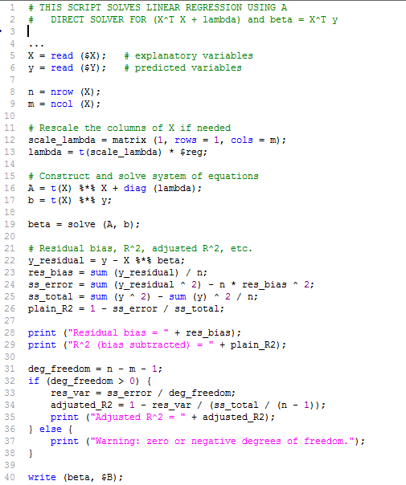

Compilation of Execution plan for bigr.lm()
Data Characteristics
Cluster Configuration
X
500
y
1
3.5 GB Map Task JVM
7 GB In-Mem Master JVM
128 MB HDFS block size
300M
300M
4 TB text file
9 GB text file
1k
X=
1k
(automatic, internal matrix block
representation)
How will execution plan change, if changes in
Data characteristics
  More columns and rows
  Less columns and rows
Cluster characteristics
  Smaller task JVM size
…
y’
Hadoop
distributed
cache
  Mappers compute
  X’X for each block in X
M
M
…
M
  y’X for each block in X,
  because X’y rewr to (y’X)’
+
+
+
  Combiners partial aggr. intermediate blocks
1 MR Job
R
  Single reducer for final aggregation as only 1 result block
A=
b’
In-Mem Master
Compute b, and execute solve(A, b) on small A, b (<2 MB)
beta=

Slide 15
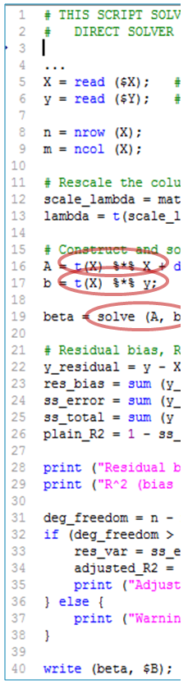
Different Execution Plans for bigr.lm, if …
Data:
Data Characteristics
Cluster Configuration
X
500
y
1
solve
3.5 GB Map Task JVM
7 GB In-Mem Master JVM
X’X and
X’y job
300M
300M
Data: X has 3 times more columns
X
1500
y
1
solve
3.5 GB Map Task JVM
7 GB In-Mem Master JVM
X’X job2
300M
300M
X’y job
X’X job1
Data: X has 2 times more rows
solve
X
500
y
1
X’y job2
3.5 GB Map Task JVM
7 GB In-Mem Master JVM
X’X job
600M
600M
X’y job1
Data: X is small and fits in memory
X
100
y
1
Solve
X’X
X’y
3.5 GB Map Task JVM
7 GB In-Mem Master JVM
1M
1M
Cluster: Change in Cluster configuration
solve
X
500
y
1
X’y job2
1.5 GB Map Task JVM
7 GB In-Mem Master JVM
X’X job
300M
300M
X’y job1

Slide 16
IBM BigInsights Machine Learning - Future
Platform to build, customize and run pre-processing, feature engineering, and machine learning algorithms in R-like syntax.
Cost-based compilation of machine learning algorithms generates execution plans
  for single-node in-memory, cluster, and hybrid execution
  for varying data characteristics:
    varying number of observations (1,000s to 100s of millions)
    varying number of variables (10s to 10s of millions)
    dense and sparse data
  for varying cluster characteristics (memory configurations, degree of parallelism)
Out-of-the-box, scalable machine learning algorithms
  e.g. descriptive statistics, regression, clustering, and classification
"Roll-your-own" algorithms
  Enable programmer productivity (no worry about scalability, numeric stability, and optimizations)
  Fast turn-around for new algorithms
Machine-learning specific language constructs such as ensemble learning and cross-validation
Higher-level language shields algorithm development investment from platform progression
  Yarn for resource negotiation and elasticity
  Spark for in-memory, iterative processing
Machine-learning specific data transformations
Embrace R Ecosystem introducing IBM BigInsights R package

Slide 17
Thank You
Notes:
IBM Insight 2014

